Slide 1
CSE 474 Software Design and Architecture
Lecturer Rabia Khan

Slide 2
About the Course
Credit hours: 3 + 1
Textbook
  Applying UML and Patterns; An Introduction to Object-Oriented Analysis and Design and Iterative Development, by Craig Larman. 3rd Ed., Prentice-Hall, 2005. (ISBN 0-13-148906-2)
  Design Patterns: Elements of Reusable Object-Oriented Software, by Erich Gamma, Richard Helm, Ralph Johnson, and John Vlissides. Addison-Wesley, 1994.
  Software Architecture in Practice; by Bass et al, Addison Wesley, 1998, ISBN 0- 201-19930-0
Lectures will be uploaded on LMS

Slide 3
Evaluation Criteria
Quizzes 10%
Assignments 10%
Midterm Exam 30%
Final Exam 50%
Quizzes will be unannounced
Late submission of assignment will be penalized
Copying will not be tolerated and will be dealt with very seriously. You are advised to do and submit your own work.

Slide 4
Course Overview
Software design strategies and methods
  - Design Principles
  - Function-oriented design
  - Object-oriented design
  - Data-structured-oriented design
• Software design notations and documentations
  - Object Oriented Design
  - OO Concepts
  - Reuse in OO Design
  - Responsibility Driven Design
  - UML Diagrams

Slide 5
Course Overview
Software architectural design
  - Architectural structure and viewpoints
  Architectural vs. detailed design
  Architectural styles and patterns
Introduction to Design patterns
  - Usage and Benefits
  - Pattern applications
  - GRASP Patterns
  - GoF Creational, Behavioral and Structural patterns,
  Factory, Abstract Factory, Singleton, Adapter, Façade pattern, Observer, Strategy pattern
Basics of software metrics
Re-engineering and reverse engineering techniques.

Slide 6
Discussion
What’s an Architecture and why study it??

Slide 7
Why do we need ‘Architecture’?
To Understand the system
  Complex systems
To Organize the development
  According to architectural partitioning
Reuse
  Componentization
Evolution
  Changes and dependencies

Slide 8
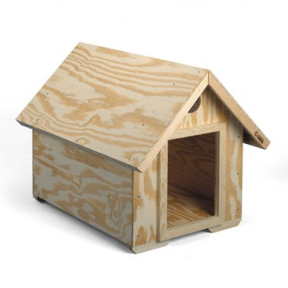
Architecting a dog house
Can be built by one person
Requires
Minimal modeling
Simple process
Simple tools
Notes:
.

Slide 9
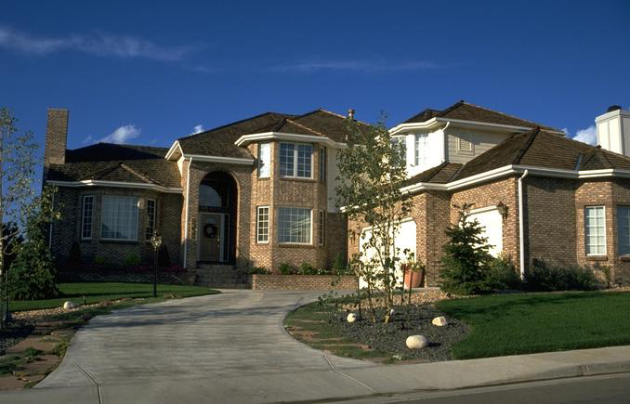
Architecting a house
Built most efficiently and timely by a team
Requires
Modeling
Well-defined process
Power tools
Notes:
.

Slide 10
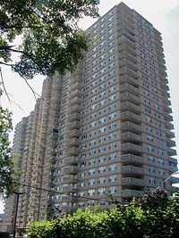
Architecting a high rise
Notes:
.

Slide 11
Differences
Scale
Process
Cost
Schedule
Skills and development teams
Materials and technologies
Stakeholders
Risks

Slide 12
Agenda
What is Architecture and why study it?
The Need of Architecture..
What’s Software Architecture/Design?

Slide 13
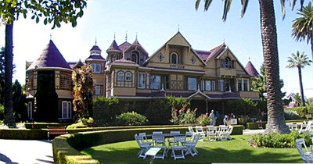

The Need of Architecture
The Winchester “Mystery” House
38 years of construction – 147 builders 0 architects
160 rooms – 40 bedrooms, 6 kitchens, 2 basements, 950 doors
65 doors to blank walls, 13 staircases abandoned, 24 skylights in floors
No architectural blueprint exists
Notes:
.
At a cost of over $70 million and under continuous construction for 38 years, Sarah Winchester’s house grew to over 160 rooms, 47 fireplaces, 10,000 window panes, 17 chimneys (with evidence of two others), two basements and three elevators. The problem? The mansion is renowned for its size and utter lack of any master building plan. The result? Doors that open into brick walls or sheer drops, stairs that lead into the ceiling, and floors that do not line up from one room to another.
Unfortunately most businesses are like the Winchester Mystery House – built without a plan. The result? No business architecture and no business blueprints that create similar issues of things not lining up, dead ends, and lots of time and money wasted on rework or worse. The reason? Most business owners are daunted with the task of writing their plan so it never gets done.

Slide 14
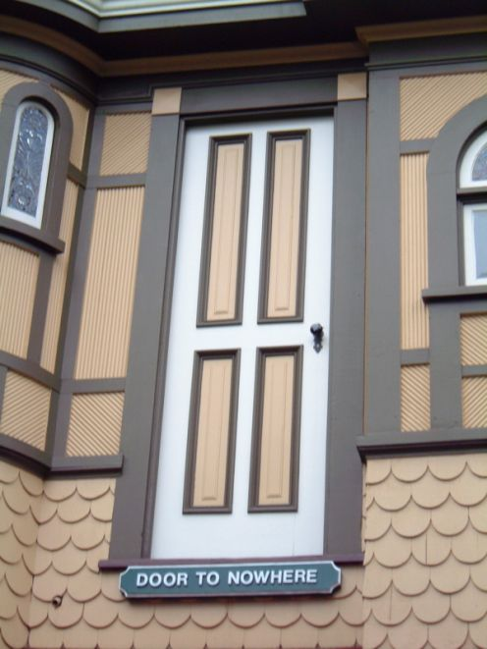
The Need of Architecture
The Winchester “Mystery” House
The Door To NoWhere in The Winchester “Mystery” House that is on the second floor and opens to the outside…

Slide 15
Agenda
What is Architecture and why study it?
The Need of Architecture..
What’s Software Architecture/Design?

Slide 16
What does this figure depict??
Semantic Data
model
Context Model
Behavioral
model
Data design
Design
Architectural
design
Code
Other
requirements
Integrated
& validated
software
Procedural
design
Program
modules
Test

Slide 17
Software Architecture defined - Formal Definition
IEEE 1471-2000
  Software architecture is the fundamental organization of a system, embodied in its components, their relationships to each other and the environment, and the principles governing its design and evolution
Notes:
.
Emphasize that the rationale for the architectural decisions is very important.

Slide 18
Software Architecture
Software architecture encompasses the set of significant decisions about the organization of a software system
  Selection of the structural elements and their interfaces by which a system is composed
  Behavior as specified in collaborations among those elements
  Composition of these structural and behavioral elements into larger subsystems
  Architectural style that guides this organization
Notes:
.
Emphasize that the rationale for the architectural decisions is very important.

Slide 19
Architecture is Early
Architecture represents the set of earliest design decisions
  Hardest to change
  Most critical to get right
Architecture is the first design artifact where a system’s quality attributes are addressed

Slide 20
Architecture Drives
Architecture serves as the blueprint for the system and project:
  Team structure
  Documentation organization
  Work breakdown structure
  Scheduling, planning, budgeting
  Unit testing, integration
Architecture establishes the communication and coordination mechanisms among components

Slide 21
Architecture vs. Design
Architecture: where non-functional decisions are cast, and functional requirements are partitioned
Design: where functional requirements are accomplished
architecture
non-functional requirements
(“ilities”)
design
functional requirements
(domains)
Notes:
.

Slide 22
System Quality Attribute
Performance
Availability
Usability
Security
Time To Market
Cost and Benefits
Projected life time
Targeted Market
Integration with Legacy System
End User’s view
Business
Community
view
Maintainability
Portability
Reusability
Testability
Developer’s view
Notes:
.

Slide 23
Significance of Software Design
“Software Design and Architecture serves as the blueprint for both the system and the project developing it, defining the work assignments that must be carried out by design and implementation teams in an estimated time”

Slide 24
Significance of Software Design
When you take the time to properly design, implement, document, and evaluate a software architecture, you can
  predict, achieve, and control quality attribute behavior and make practical tradeoffs early
  greatly reduce the failure rates of software projects
  produce a rationale for certain architectural decisions made or not made
  communicate with your stakeholders
  reason about and manage change
  enable more accurate cost and schedule estimates
  create evolutionary prototypes
  predict and mitigate risks
  understand the tradeoffs inherent in the architectures of software-intensive systems
  provides insight into how quality goals interact—that is, how they trade off
  plan your staffing needs

Slide 25
Some questions
What does the term Software Architecture mean?
What does Software Design mean?
  Software design is a process of problem-solving and planning for a software solution. After the purpose and specifications of software is determined, software developers will design or employ designers to develop a plan for a solution. It includes low-level component and algorithm implementation issues as well as the architectural view.
Why is it needed?
What is the difference between the two?
Architecture is the blue print of the system. It does not concern itself with the details of the system, but rather how components relate to one another.
Design is the next level of detail.

Slide 26
Software Design in SDLC
In SDLC (Software Development Life Cycle), Design phase is one of the most important phases.
In the software engineering context, design focuses on four major areas of concern: data, architecture, interfaces and components.

Slide 27
Design Process
During the design process, the software specifications are transformed into design models that describe the details of the data structures, system architecture, interface, and components.
The emphasis in design phase/process is on quality.
This phase provides us with representation of software that can be assessed for quality.

Slide 28
Design Process Activities
Architectural design
  Modules, inter-relationships etc
Abstract specification
  Services of each sub-system, constraints etc
Interface design
  Interface to other sub-system or outside env
Component design
  Services allocated to components and their interfaces designed
Data structure design
Algorithm design

Slide 29
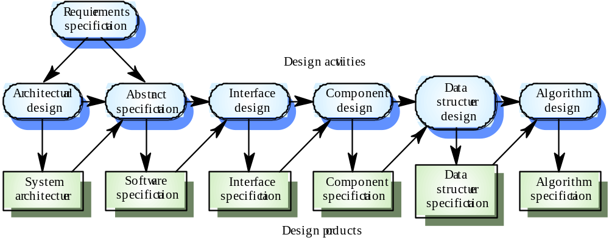
The Software Design Process

Slide 30
Levels of Software Design
Architectural design (high-level design)
  architecture - the overall structure, main modules and their connections
  addresses the main non-functional requirements (e.g., reliability, performance)
  hard to change
Detailed design (low-level design)
  the inner structure of the main modules
  detailed enough to be implemented in the programming language

Slide 31
Qualities of a Good Design
Design should:
  exhibit good architectural structure
  be modular
  contain distinct representations of data, architecture, interfaces, and components (modules)
  lead to data structures that are appropriate for the objects to be implemented and be drawn from recognizable design patterns
  lead to components that exhibit independent functional characteristics
  lead to interfaces that reduce the complexity of connections between modules and with the external environment
  be derived using a reputable method that is driven by information obtained during software requirements analysis

Slide 32
How to know if Design is bad?
changes to single module propagate via dependencies to other Modules (Rigidity)
  even small changes can cause cascading effects to many places
code breaks in unexpected places having no conceptual relationship with the area that was changed (Fragility)
  fixing the problems causes new problems
code is so tangled that it's impossible to reuse anything (Immobility)
no understandability
a module could be reused in another system, but the effort and risk of separating the module from original environment is too high

Slide 33
Characteristics of good and bad design
Good Design | Bad Design
1. Change in one part of the system doesn't always require a change in another part of the system. Every piece of logic has one and one home. It is cost effective The logic is near the data it operates on. 5. System can be extended with changes in only one place. 6. Simplicity | One conceptual change requires changes to many parts of the system. Logic has to be duplicated. 3. Cost of a bad design becomes overwhelming. 4. Can't remember where all the implicitly linked changes have to take place. 5. Can't add a new function without breaking an existing function. 6. Complexity

Slide 34
How to avoid bad design?
Follow Design Principles
Use established Design Patterns

Slide 35
Software Design Principles
The design process should not suffer from tunnel vision
  – A good designer should consider alternative approaches.
The design should be traceable to the analysis model
The design should not reinvent the wheel
The design should minimise intellectual distance between the software and the problem as it exists in the real world
  That is, the structure of the software design should (whenever possible) mimic the structure of the problem domain.
The design should exhibit uniformity and integration
  A design is uniform if it appears that one person developed the whole thing.
  A design is integrated if care is taken in defining interfaces between design components.

Slide 36
Software Design Principles contd…
The design should be structured to accommodate unusual circumstances, and if it must terminate processing, do so in a graceful manner.
The design should be reviewed to minimize conceptual (semantic) errors
Design is not coding, coding is not design
  Even when detailed designs are created for program components, the level of abstraction of the design model is higher than source code.
The design should be structured to accommodate change
The design should be assessed for quality as it is being created

Slide 37
Established Design Patterns
GRASP (General Responsibility Assignment Software Patterns)
GoF (Gang of Four) Patterns
Will be covered later in detail

